Slide 1
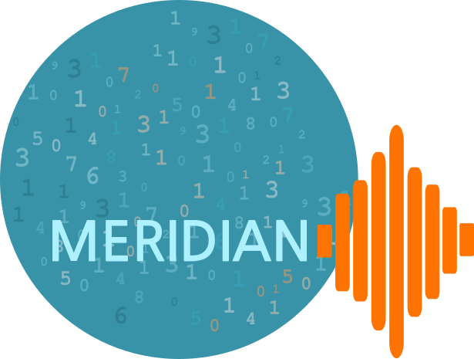
Designing data discovery @ MERIDIAN
An introduction to metadata
and the MERIDIAN metadata profile
Kim Mortimer MERIDIAN
2021-01-20 - Webinar - MERIDIAN

Slide 2
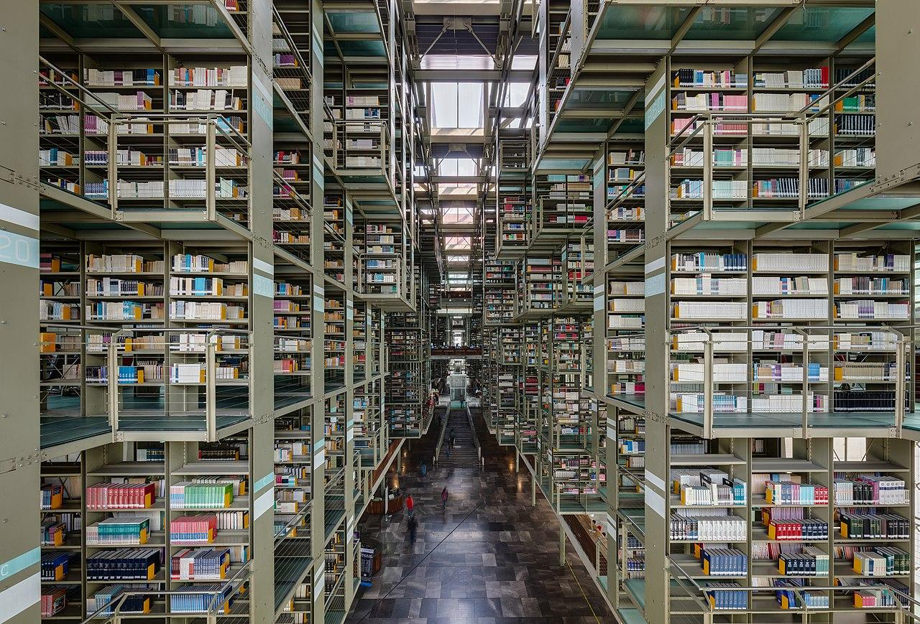
Metadata is for describing things (usually data)
Metadata extends beyond title, description… into easily overlooked content
Obvious historical debt to libraries
Choice, usefulness, of metadata depends on purpose and audience
Structuring metadata greatly increases its value
Biblioteca Vasconcelos. Diego Delso, delso.photo, License CC-BY-SA. Retrieved from Wikimedia Commons.
2021-01-20 - Webinar - MERIDIAN
Notes:
Metadata is data about data (or information about information, or some mix). There are obvious things that fall under the purview of metadata - title, date of creation… but also consider, for your digital files: file size, file format, what program opens it, what program created it…
Though it might have been some time since you were last in a library, library catalogues are really metadata catalogues - a storehouse for metadata about books. They moved from card catalogues to digital catalogues, but the core idea is still the same.
One key point that I think people often overlook is that your purpose and audience do matter. The metadata you store for an academic journal is probably different from that for a children’s book, even if they might both in the same library. Likewise, useful metadata for a librarian is probably different from that of the reader.
Finally you want to structure things - store the same metadata in the same way each time. For example, dates - writing the dates inconsistently will make it hard to compare when things were created.

Slide 3
The intersection of audience, purpose, and structure
Digital library catalog might track number of e-reader copies, software required...
Even the same object may have different metadata when aspects of the above change
A physical book might appear in a public library (audience and purpose) catalog (structure) and list author, year of release, themes...
A physical book in a supplier’s (audience and purpose) database (structure) might list weight, size, number of books per box...
Physical library catalog might store shelf location, info on interlibrary loaning, details on repairs...
2021-01-20 - Webinar - MERIDIAN
Notes:
Going a bit deeper, the metadata you use will - most likely - be chosen based on your audience, your purpose, and what structures you can use or are available to you. A public library is different than an archive, both in form and purpose… Things that are important for one group of people may not be relevant for a second.
In my opinion, this is one of the hardest parts of designing a metadata system - you are anticipating what your users will want from, and intend to do with, your product - your product that is still in the development phases, and has no real users.
Sometimes the solution here is to take a broad view of what is needed, but that can also mean you have more work to do.

Slide 4
Metadata structures - background
When metadata structures are widely adopted, it allows interoperability and expands searches
Frequently a metadata structure is determined by the relevant discipline
Individual groups or projects may make modifications to a general structure to support specific efforts
Shipping containers in SF Bay. MGunn, Public Domain. Retrieved from Wikimedia Commons.
2021-01-20 - Webinar - MERIDIAN
Notes:
By widely adopted, I mean that multiple groups use the same structure - to a degree, anyways. By interoperability, I mean the ability for one search service to index the results of multiple sites - this in turn reduces the number of ‘stops’ a given user has to make to find a given dataset. (Picture: If every shipping container structure was differently sized, it would be more difficult to fit large numbers of containers on a given ship - especially since you have to worry about balance and stability)
If you’re in an established discipline with lots of existing shared data, you’re very likely going to have to provide metadata to match that existing data - in this way, certain structures become more dominant in a given field. You can always try to shake things up by changing what you provide, but then you run the risk that your data will be rejected or otherwise not be as easily found.
Of course as you get into bigger groups, it becomes easier to form sustainable independent structures. So groups can start making their own changes to meet what they’ve identified as their local needs - even if they don’t necessarily fit into the bigger picture of their discipline exactly. But there is still a risk and a cost to that...

Slide 5
Metadata structures - advanced
Metadata standard
To the right is a typical arrangement - exceptions exist
Standards may be abstract, frequently developed by organizations like ISO
Schemas describe how a metadata element and its value are ‘written down’
Metadata profile
Metadata schema
Implementation
2021-01-20 - Webinar - MERIDIAN
Notes:
This is just one set of terminology that I personally prefer - it’s likely if you refer to other sources, books, or experts, they will refer to these same concepts in different ways.
This is essentially moving from the most abstract outer ring, to the most applied inner ring. Standards may be abstract and lack precise rules. Profiles are when you start applying precise rules - based on those of the standard, plus whatever local modifications you wish to apply. So - ISO 19115 is a standard developed by the International Organization for Standardization, but there are North American (NAP), Australia/New Zealand (ANZLIC), European (INSPIRE)… profiles. A good place to learn more about this is here https://www.dcc.ac.uk/resources/metadata-standards/iso-19115
Schemas are the ‘dictionary’ or ‘language’ of metadata. A given standard or profile may have multiple schemas, depending on how many languages it is intended to be written into. (We’ll get into Darwin Core later, which has one prominent schema and at least 2 others).
Finally there’s the implementation, which might change the schema for interoperability or ease of development. My colleague, Sarah, will be talking more about this later, and you will also hear from Kelly Stathis on some of FRDR’s implementation.

Slide 6
Metadata - a hypothetical example
4. iv) Each metadata record MUST contain a title of the associated dataset
Metadata > Dataset information
Title (Mandatory; not repeatable)
<md_Metadata>
<di_Dataset>
<xs:element name=”title” type=”string” minOccurs=”1” maxOccurs=”1”>
</di_Dataset>
</md_Metadata>
Enter a title for your record:
I
Advice: Use a human-readable title
2021-01-20 - Webinar - MERIDIAN
Notes:
This is strictly hypothetical, but is based on my own experience working with ISO 19115 in XML (ISO 19139) - if you are very familiar with ISO 19115 you might recognize my inspiration.
I’ve used different fonts and representations to try to draw visual attention to the differences in each step. So, top is the standard, then you get into the profile, then a schema (in XML) and finally an implementation (e.g., as a web form). This is just an example and is not valid metadata in any way. There are also many other possible ways metadata can ‘evolve’ from theory to practice.

Slide 7
MERIDIAN’s metadata - the theory
Audience
Purpose
Structure
Researchers, scientists, programmers, decision-makers, general public...
Store metadata about ocean acoustic data, software that works with ocean acoustic data, acoustic models...
Open source, interoperable, building on existing standards, Cloud compatible...
As simple as possible
Store only metadata, about many things
Use public existing systems as much as possible. Embrace Cloud infrastructure.
2021-01-20 - Webinar - MERIDIAN
Notes:
On this slide I want to showcase some of the decision making processes and user experiences we tried to incorporate while developing our Metadata system.
We had some idea of what the audience might be based on existing repositories, and from our initial MERIDIAN proposal. But this was a very broad spectrum of users - with a variety of experiences and intents - so we ended up deciding to try to go simple, to reduce the risk of misinterpretation or alienation. But there is potentially a cost, as we also need to have enough metadata to satisfy the experts.
Our purpose was laid out in the initial MERIDIAN proposal - to store metadata. We also weren’t going to be a data store. We didn’t have a lot of restrictions on the types of data we wanted described - only that it somehow related to ocean research and more specifically ocean acoustics. So we needed a robust metadata system which could accept metadata about a variety of things.
The structure was partially defined by the desire/need to be interoperable and open source. Since we were working in ocean research, we ended up referring to existing ocean metadata systems - such as the Marine Community Profile, or SeaDataNet - which predominantly (but not exclusive) used ISO 19115 profiles. And rather than reinvent the wheel there, we tried to use an existing tool - GeoNetwork - to serve as a cloud-compatible foundation for our system.

Slide 8
MERIDIAN’s metadata - the foundation
Core:
Metadata standard
Metadata profile
Metadata schema
ISO 19115-2:2009
Guide to Implementing ISO 19115-2:2009(E), the North American Profile (NAP), and the ISO 19110 Feature Catalogue [NOAA, January 2012]
ISO/TS 19139-2:2012
MAJOR GAP: Biological data (species detected, number of animals detected, etc…)
2021-01-20 - Webinar - MERIDIAN
Notes:
The first draft of MERIDIAN’s metadata system looked something like this.
You might note that 2009 is a long time ago - you’re right. ISO 19115 was due to be revised in 2019, but it wasn’t officially released when we started working on this, so we fell back to the older version.
Given we’re Canadian, we started with the NAP, then found an extension, ISO 19115-2, which included metadata for instruments and platforms - which we thought was relevant as we knew there was glider research and research vessels which incorporated acoustic data collection. NOAA’s profile for ISO 19115-2 ended up being the foundation of the metadata profile.
We finally opted to use the XML schema for ISO 19115, as that worked well with GeoNetwork.
But at this point we saw a problem - there was no real way in this metadata profile (and schema) to record structured information about the animals in a given audio recording. There is a biological extension for ISO 19115 that we considered including, but it wasn’t widely adopted or supported - it would be about as hard to implement as any other extension. So we made a different decision...

Slide 9
MERIDIAN’s metadata - the extras
Biological extension:
Metadata standard
Metadata profile
Metadata schema
Darwin Core [Darwin Core Maintenance Group, 2019]
#N/A
Darwin Core XML guide [Darwin Core Task Group, 2015]
PROBLEM: Not easily mapped to, e.g., OBIS star schema...
2021-01-20 - Webinar - MERIDIAN
Notes:
To take a second metadata standard, Darwin Core, which is exclusively for biological information (including, hypothetically, acoustic information about biological entities), but not as widely used in ocean research (the major exception being OBIS). Conveniently, Darwin Core has an XML schema as well.
There are several problems with this - the most significant is that the XML schema for Darwin Core isn’t as popular as the star schema, in which multiple files are linked together from a central file - hence a ‘star’ with connections radiating outwards. This star schema is what OBIS uses. And XML is a single file - so it wouldn’t be convenient or easy to split that data up into multiple files if we wanted to connect our data with OBIS’.

Slide 10
MERIDIAN’s metadata - the results
MERIDIAN Profile:
Metadata standard
Metadata profile
Metadata schema
ISO 19115-2:2009 containing Darwin Core
Variant of NOAA with added Darwin Core elements
ISO 19139-2:2012 with custom elements and namespace to support Darwin Core XML
2021-01-20 - Webinar - MERIDIAN
Notes:
The result is of combining the two XML schemas is a profile which incorporates two standards into a single schema. Essentially, it is a modification of ISO 19115-2:2009 using a custom namespace - to support the custom Darwin Core elements, along with a few other elements - into a single XML file. You can think of it as a Darwin Core file nested inside an ISO 19115 file, with support to prevent that from being rejected as not conforming to the original ISO 19139 schema.

Slide 11
Benefits and drawbacks
Structure is compatible with existing tools, easy to compare
Suitably generic for purpose, audience
Contains specific changes according to our purpose
Can contain biological metadata, which can be easily isolated
But requires crosswalk anyways due to namespace change
Requires conditional statements and possible exceptions
These changes may complicate crosswalks in certain scenarios
Crosswalking to ISO 19115 repositories will (probably) lose either data or structure of biological component
2021-01-20 - Webinar - MERIDIAN
Notes:
Of course, since we did something custom and unique, this does mean it’s not a single one-to-one translation to make our metadata compatible with other ISO 19115 metadata repositories. However, the core structure is sufficiently similar that we can simply change the namespace of our modified elements back to the original ISO 19139 namespaces, and discard the new elements, to make a quick and painless ‘crosswalk’ or translation.
We’ve made some minor modifications to zoom in on our area of interest - oceans and acoustics - and to support software and data - but this does mean when implementing it, there are some conditional statements and exceptions to certain things. But we do think it’s generic enough, at this time.
The main benefit is the fact we can contain Darwin Core data. In fact, an entire Darwin Core XML file could be added inside one of our metadata records without problems - except for crosswalking. But turning that into a star schema layout would be complicated - we have an assumption about how that ‘star’ is formed, with respect to the interconnections between Darwin Core elements, which in turns means that has to be preserved when exporting. The simple solution is to toss all the Darwin Core elements into a single free text field when exporting to another repository, but that does mean the structure is not preserved. Otherwise, as mentioned previously, we can discard it entirely.

Slide 12
Future work
Update to ISO 19115-2:2019, keep Darwin Core fragment up-to-date
Development of crosswalks for relevant profiles/schemas (e.g. CIOOS, FRDR…)
Respond to professional feedback
Retire GeoNetwork instance and develop APIs for MongoDB instance
2021-01-20 - Webinar - MERIDIAN
Notes:
There is still work to be done - and the passage of time ensures we must keep on our toes.
The big upcoming change is to move to ISO 19115-2:2019, as it was released shortly after our initial profile release. Darwin Core is also being continuously updated (unlike ISO which has set revision periods) which may cause perennial problems.
We do need to develop our crosswalks to link our metadata with other repositories, such as FRDR and potentially the CIOOS metadata repository.
We’re also always looking for feedback on the profile (and our implementation, as Sarah will talk about later I’m sure). Since we will shortly be revising to ISO 19115-2:2019, now would be a great time for others to provide feedback, if they are able. I also want to thank the CIOOS’ metadata team for having discussed our profiles briefly.
Finally, as mentioned previously we initially used a GeoNetwork deployment as our metadata repository, but last year we moved over to a MongoDB instance storing the metadata in JSON and exporting it to XML. As such, the schema documentation needs to be updated, and we would like to eventually develop APIs for MongoDB to allow us to retire GeoNetwork entirely

Slide 13
Conclusion
MERIDIAN’s metadata profile is an attempt to satisfy the requirements of our unique purpose and audience within existing structures
Choices made during development offer both benefits and drawbacks from a metadata perspective
Future crosswalk work essential for discovery purposes and interlinking with other research systems
Full documentation
docs.meridian.cs.dal.ca/metadata/
GeoNetwork plugin
gitlab.meridian.cs.dal.ca/Infrastructure/iso19139.MERIDIAN/
Notes:
Hopefully through this presentation you understand a bit better why MERIDIAN (and I) made the choices we did for the metadata profile. We were trying to serve our specific audience, and our grant-defined purpose, using existing structures wherever possible. However, the modifications we made to support this audience and purpose results in our structure differing from other comparable tools. There are benefits and drawbacks to the choices we made, some of which I’ve made obvious through this presentation.
Beyond updating our profile, we are really invested in developing crosswalks to interlink our metadata with other services - to help preserve MERIDIAN in the event we cease to function/exist, and getting our name out there on bigger services.
If you are interested in getting more details on our profile, you can visit our documentation or download our GeoNetwork plugin (which is slightly out of date). I’d also be happy to answer questions @ k.mortimer@dal.ca .

Slide 14
Thank you! Any questions?

Slide 15
Slide title
Slide content
2021-01-20 - Webinar - MERIDIAN

